Slide 1
신호 최적화 최종발표
ETRI연구연수생 강민수

Slide 2
Contents
Current Model
3x3Grid Single-Agent Model without Restraints(Depreciated)
3x3Grid Decentralized Model without Restraints(Depreciated)
3x3Grid/Dunsan Decentralized Model with Practical Restraints
Dunsan Decentralized CNN Model with Practical Restraints
Dunsan Decentralized CNN reduced Model with Practical Restraints
Upcoming Model
Continuous Action Model with Practical Restraints

Slide 3
3x3Grid Single-Agent/Decentralized Model without Restraints(Depreciated)
Condition (seed fixed)
Generating probability 0.133 (left, right), 0.388 (up, down)
Restricted direction of vehicles(via)/Not restricted direction(no via)
Central agent(n_1_1), 9 Agents(decentralized)
State
The number of inflow vehicles from each inflow edge(left, straight)
Action
Deciding next phase(without an order), every 20s (with all yellow 3 seconds)
Reward
Penalty on Pressure (= inflow-outflow)

Slide 4
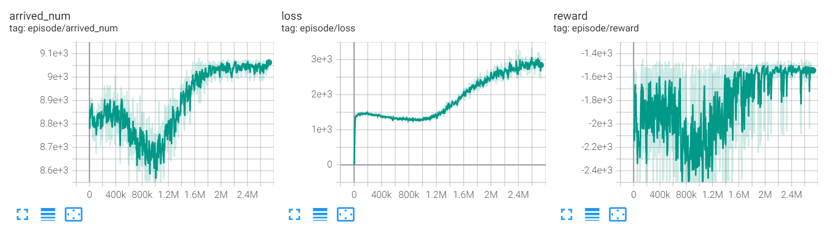

Comparison between Simulation & Single Agent
Simulation 0.133 (left, right), 0.388 (up, down), phase 42(G), 3(Y)
The number of arrived number: 8295 (no via), 8794 (via)
Experiment(Single-Agent Model)
The number of average arrived number: 9060 (no via), 9281 (via)
5~8% Increase
Agent
300m

Slide 5
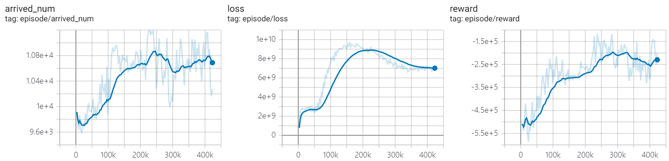
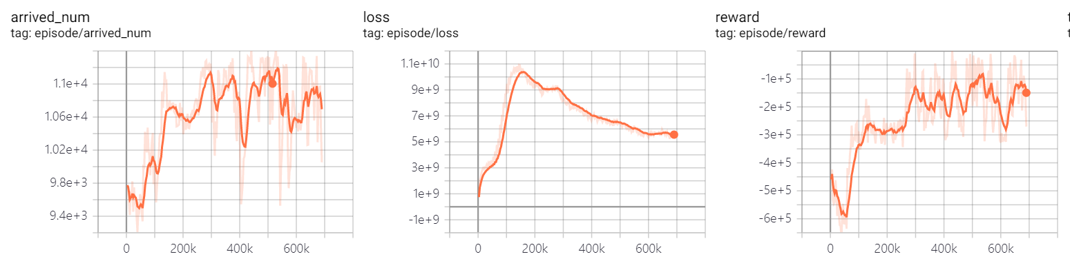
Comparison between Simulation & Decentralized Agents
Simulation 0.133 (left, right), 0.388 (up, down), phase 20(G), 3(y)
The number of arrived number: 9474 (no via), 9765(via)
Experiment(Decentralized Agents Model)
The number of avg arrived number: 10600(no via, blue), 10800 (via, orange)
10~11% Increase

Slide 6
3x3Grid Decentralized Model with Practical Restraints
Condition(seed fixed)
Random routing vehicle generation (period 0.8), scale 1.1 (by randomTrips.py)
9 Decentralized Agents(No offsets, Update Asynchronously)
4 Phases(Vertical/Horizontal straight and left) 37s each, followed by all yellow 3s
Model applied min/max duration(28s,49s) and phase period(160s)
State
The number of inflow vehicles from each inflow edge(left, straight)
Update current phase demand info from end of phase period

Slide 7
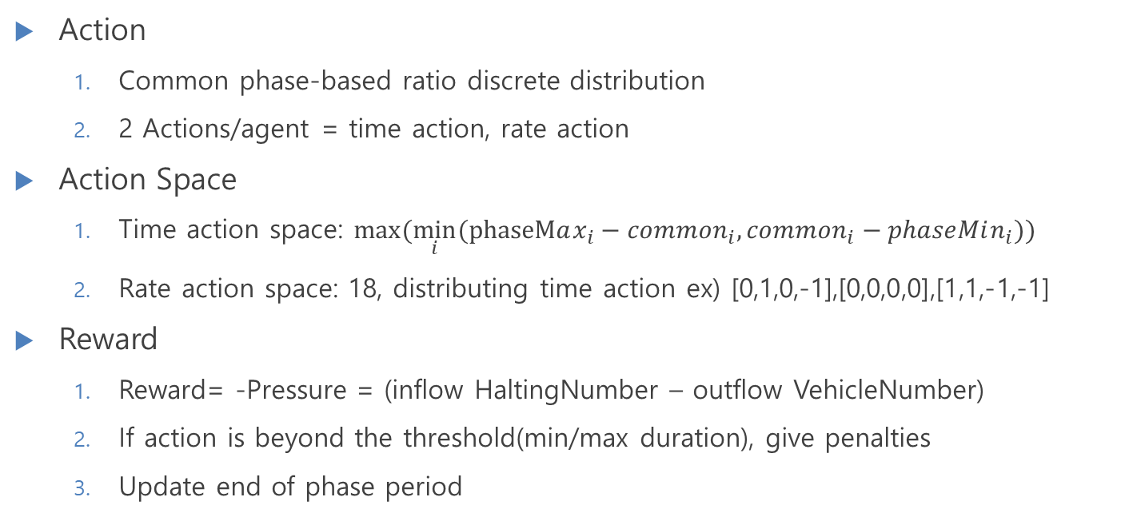
3x3Grid Decentralized Model with Practical Restraints
Action
Common phase-based ratio discrete distribution
2 Actions/agent = time action, rate action
Action Space
Time action space: $max⁡(\min_{i}⁡(phaseMax_{i}−common_{i},common_{i}−phaseMin_{i}))$
Rate action space: 18, distributing time action ex) [0,1,0,-1],[0,0,0,0],[1,1,-1,-1]
Reward
Reward= -Pressure = (inflow HaltingNumber – outflow VehicleNumber)
If action is beyond the threshold(min/max duration), give penalties
Update end of phase period

Slide 8




3x3Grid Decentralized Model with Practical Restraints
Action: $a_{t}^{i}$
RL Modeling
Agent
Agent
Agent
Agent
Environment
Traci
State:$s_{t}$
Neural Net (shared params)
Update Mask
$$i$$
TL_Period
Reward: $r_{t}^{i}$

Slide 9
3x3Grid Decentralized Model with Practical Restraints
DNN Modeling
Left Straight
Road Info from Traci
Intersection Traffic Demand
Super Q Network
Inflow Demand
Concatenated
Traffic Demand

Slide 10
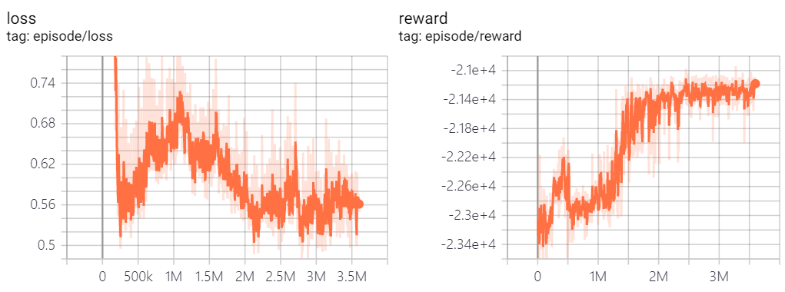
Decentralized Model with Practical Restraints
3x3 grid
9 Agents
Random Routing Generation → 1 period, 1.5 scaled
Dunsan
11 Agents
Real Demand based training → 0-3am, 2.0 scaled
Avg Value | Simulation | Decentralized
Travel Time (per edge) | 25.5s
Velocity | 2.13m/s
Waiting Time (whole trip) | 4205.5s/veh
Avg Value | Simulation | Decentralized
Travel Time (per edge) | 13.82s | 14.5s
Velocity | 5.93m/s | 5.79m/s
Waiting Time (whole trip) | 495.5s/veh | 534s/veh
Arrived Num | 10951 | 11022

Slide 11
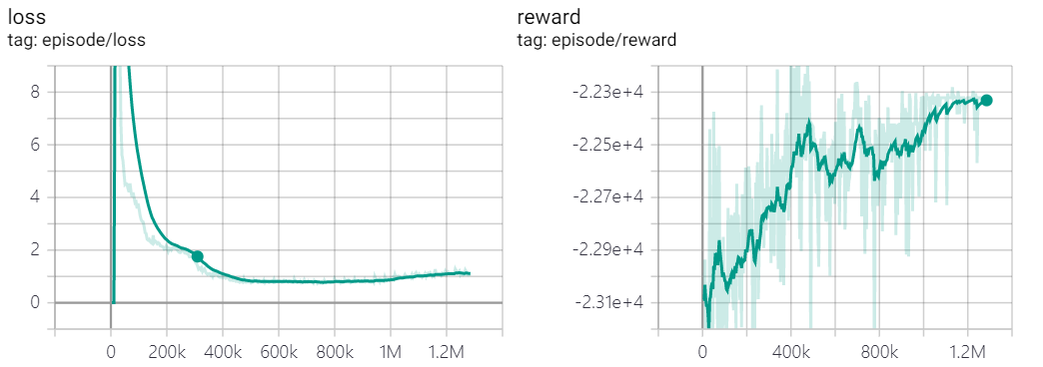
CNN reduced model

